Slide 1
Demo
Ankush Patel – CS494 – Week 9

Slide 2
CIFAR-10, STL-10 Demo
Pretrained models are in the folder
The demos apply gaussian blur to the dataset
A graph describing std. in blur vs accuracy is generated

Slide 3
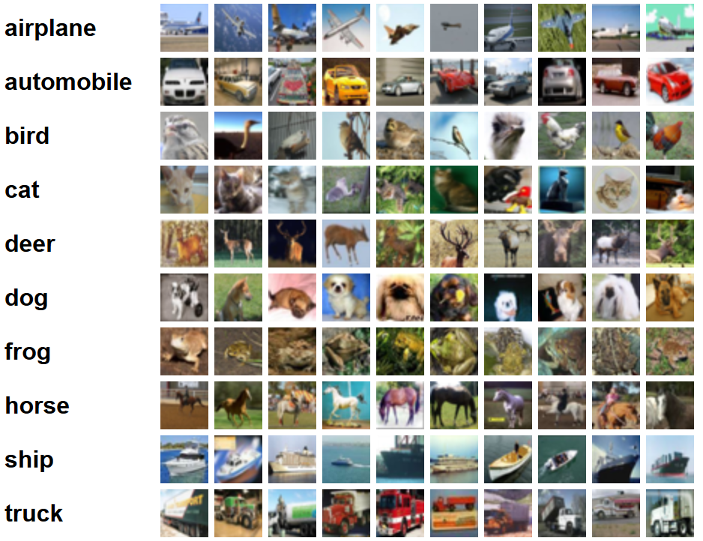
CIFAR-10
Notes:
http://www.cs.toronto.edu/~kriz/cifar.html
60000 32x32 images with 10 classes
Purpose:
A more consistent image dataset
Less time training due to smaller images

Slide 4
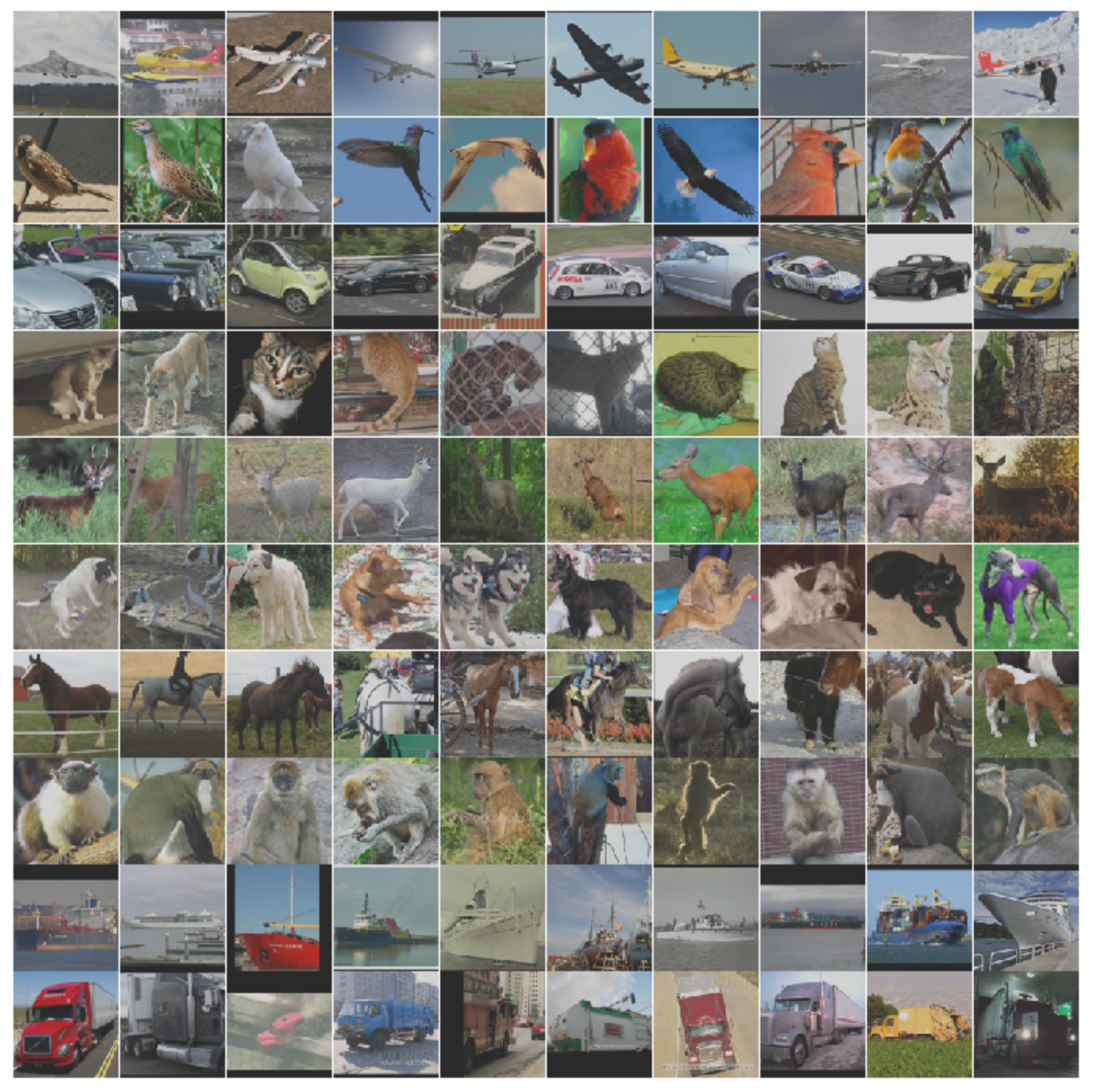
STL-10
Notes:
96x96 images that are based on the CIFAR10 dataset – possibly more noisy 100000 images

Slide 5
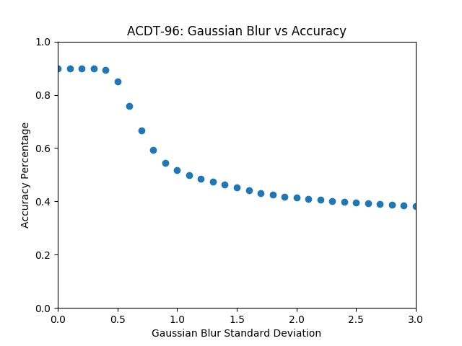
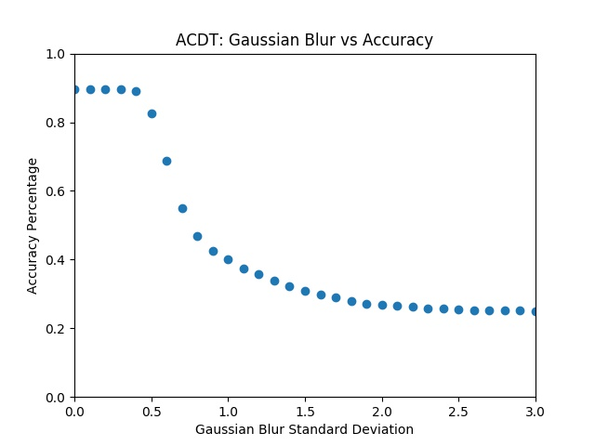
Gaussian Blur Comparison

Slide 6
Webcam Demo
The webcam is set to 640px
Both YOLOv3-spp and YOLOv3-tiny can run on the webcam
Classes compatible with the Pascal VOC dataset are detected such bottle, person, or backpack.

Slide 7
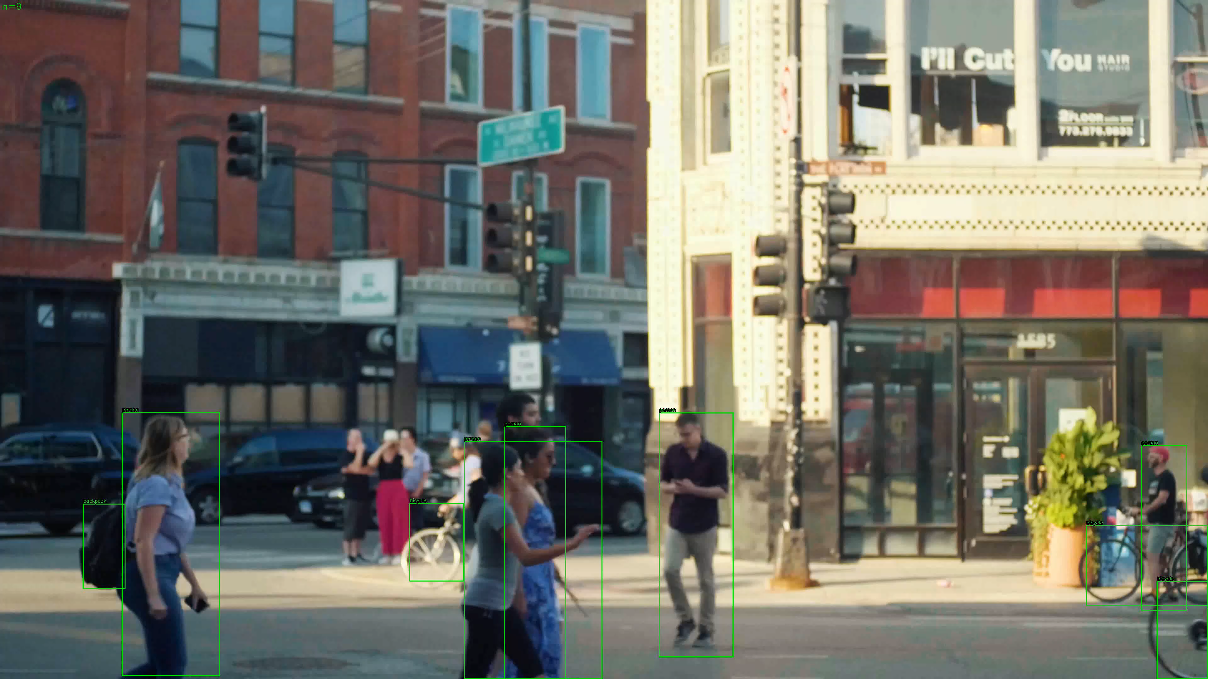
Hand Annotation
Annotated 250 frames @ 1080p
Classes: Person, Backpack, Bicycle
Took about an hour
Used dark label annotation tool
Adjusted box every ~3-5 frames

Slide 8
YOLOv3 on Video
Two street scenes day and night
These were processed at 1080p
Two models: tiny and spp

